Slide 1
2.2: Interaction Styles

Slide 2
Interaction Styles
Introduction:
Interaction styles are primarily different ways in which a user and computer system can communicate between each other.
In this presentation, we look at different interaction styles available to designers for facilitating communication between a user and computer system.

Slide 3
Types of Interaction Styles
The five types of interaction styles discussed here are:
Command – Line
Menu Selection
Form-Fill
Direct Manipulation
Anthropomorphic

Slide 4
Command Line Interfaces
Features
Means of directly instructing the system using function keys, commands or abbreviations.
Provide access to the system functionality.
Commands often have a number of options that vary its behavior and can be applied to many objects at once.
Suitable for expert users, since it provides a sense of being in control.

Slide 5
Limitations of Command line Interface
Commands and command sequences need to be remembered.
Low tolerance of errors by the interface.
High memory and typing demands.
Error messages and online assistance are hard to provide due to diverse possibilities.

Slide 6
Limitations of Command Line Interfaces
Error rates are typically high.
Training and practice is necessary .
Retention of command and command sequences are usually poor .
Commands vary between systems and are obscure.

Slide 7
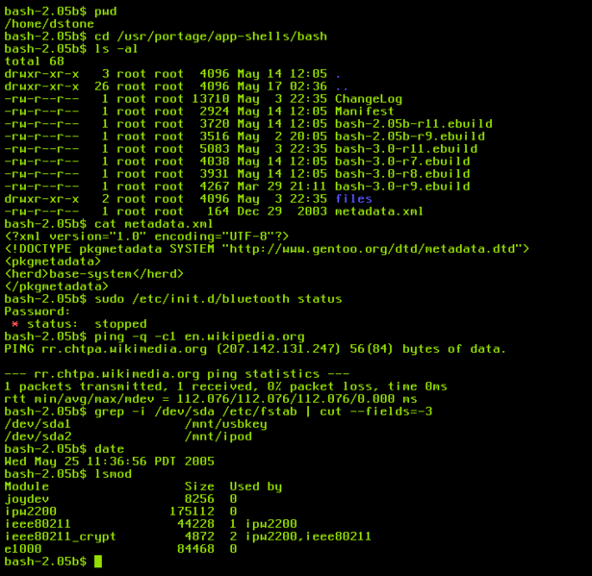

Slide 8
Menu Selection Interfaces
Interface displays options as menu items or icons for the user to choose from .
User indicates a choice and receives a feedback.
Menu Selection interface offers cues for user recognition.
Menus are to be effective, their names and icons are to be self-explanatory.
Easy for novice users to work on .
Too slow for expert users but this problem can be overcome by careful designing. (shortcuts..)

Slide 9
Form-Fill Interface
Applicable when a lot of information has to be gathered from the user.
A well designed form-fill should have a predictable order of entering data into appropriate fields.
Should ensure easy movement and correction facilities.
A form-fill interface should assist in the user in constructing an accurate mental model.

Slide 10
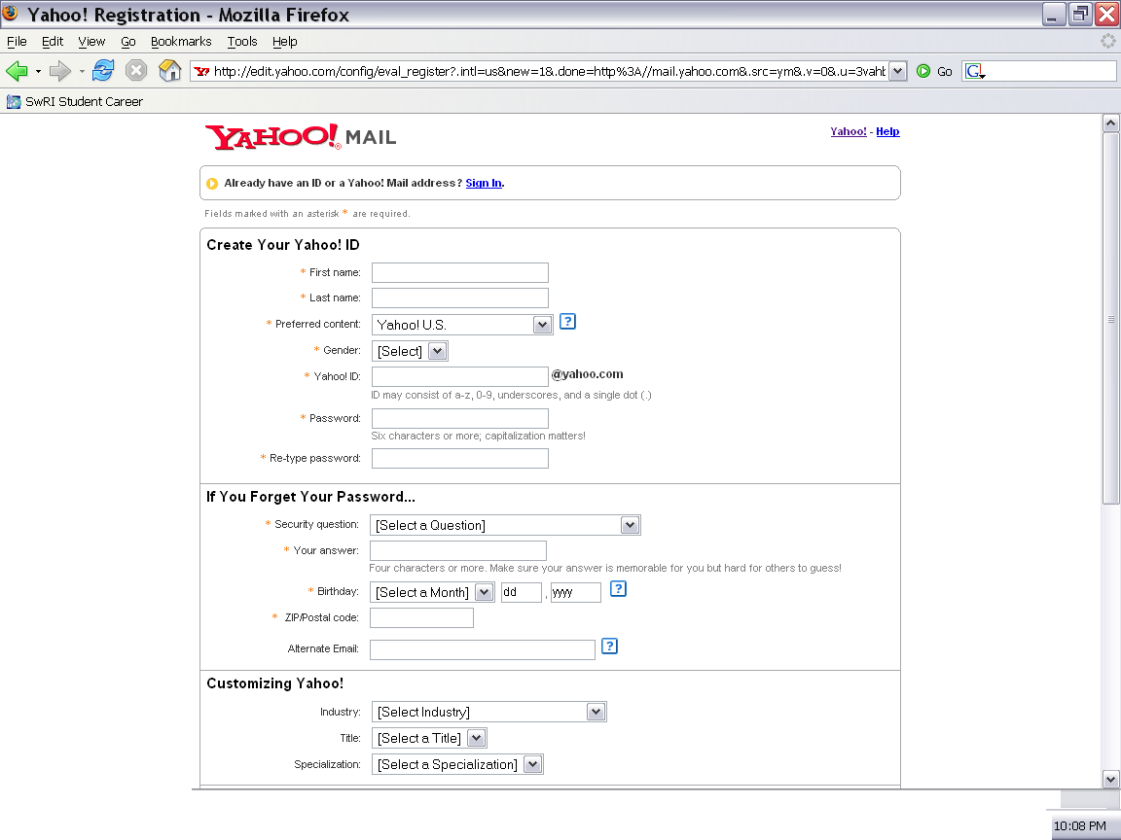

Slide 11
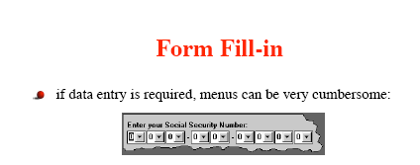
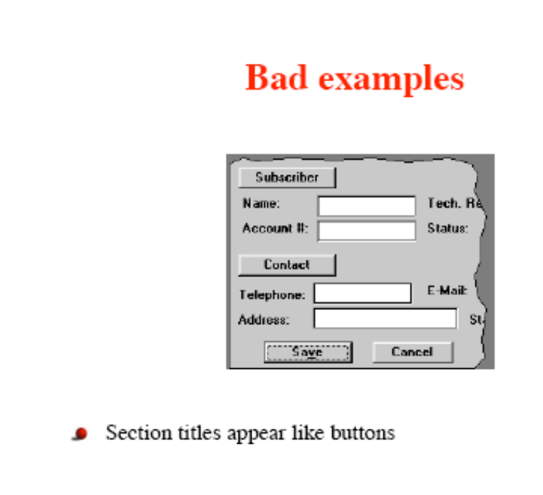
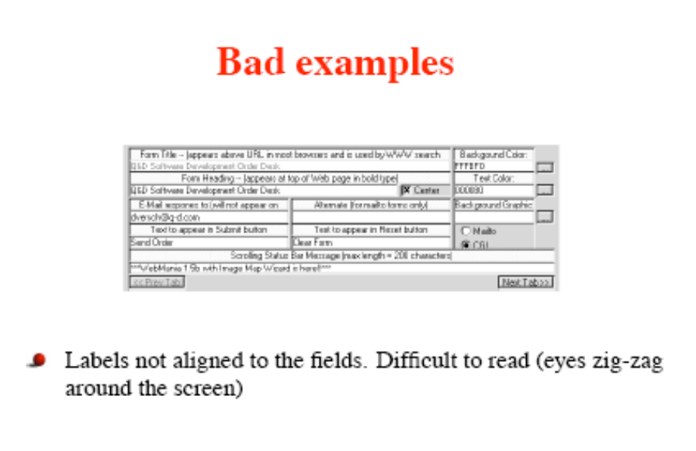
Examples of form-Fill applications

Slide 12
Direct Manipulation Interfaces
Users directly interact with the UI objects.
Continuous input devices such as mouse, pen are used replacing command entries or menu choices.
DM interfaces exist in application areas such as in CAD, word processing, video games.

Slide 13
Characteristics of DM interfaces
Little syntax to remember.
Tasks are carried out by physical actions such as clicking, dragging….
Easy for novices to learn basic functionality.
Operations are rapid, incremental, reversible and immediately visible.
Feeling of interacting directly with the domain rather than with the interface.
DM interfaces occupy a lot of screen space.

Slide 14
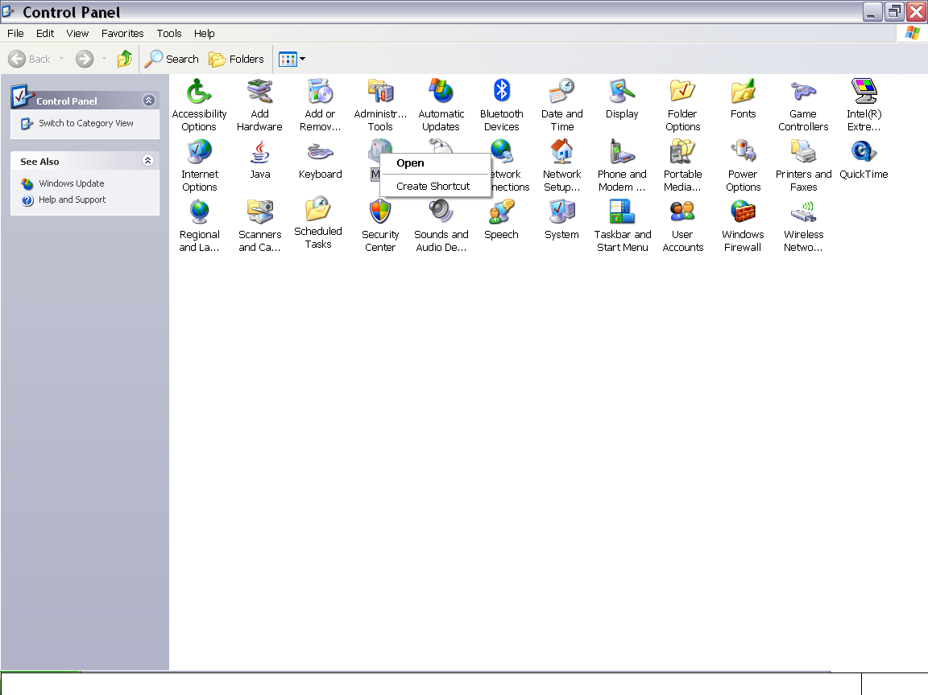

Slide 15
Anthropomorphic Interfaces
Deals with natural language interfaces, interfaces that recognize gestures, facial expressions , speech…
Understanding of human communication is necessary.
Handwriting, Typing are associated with problems of incorrect spelling, illegibility but overcome the problems of accent and intonation associated with speech.

Slide 16
Anthropomorphic Interfaces
Not yet fully developed and research being carried out on it .
Promises flexible and easy communication with computers .

Slide 17
Blending Interaction Styles
Applicable when the User interface is used for a wide range of tasks or when the experience of the users are varied.
Designer have to work from their experience and intuition when combining different interaction styles.
Choosing the right combination to combine is essential.

Slide 18
?Questions/Comments?

